Slide 1
Low Resource Neural Machine Translation
Shujie LIU
Natural Language Computing Group
Microsoft Research Asia

Slide 2
Outline
Introduction to Machine Translation
Neural Machine Translation
Low Resource Neural Machine Translation
Unsupervised Neural Machine Translation

Slide 3
Introduction to Machine Translation

Slide 4
Introduction to Machine Translation
Background of MT
Methods of MT
Evaluation of MT

Slide 5

全球现存6909种语言在使用
普通话 885,000,000
SPANISH 332,000,000
ENGLISH 322,000,000
BENGALI 189,000,000
HINDI 182,000,000
PORTUGUESE 170,000,000
RUSSIAN 170,000,000
JAPANESE 125,000,000
GERMAN 98,000,000
TURKISH 59,000,000
URDU 58,000,000
MIN NAN (China) 49,000,000
晋语 (China) 45,000,000
GUJARATI 44,000,000
POLISH 44,000,000
ARABIC 42,500,000
UKRAINIAN 41,000,000
吴 语(China) 77,175,000
JAVANESE 75,500,800
KOREAN 75,000,000
FRENCH 72,000,000
VIETNAMESE 67,662,000
TELUGU 66,350,000
粤语 (China) 66,000,000
MARATHI 64,783,000
TAMIL 63,075,000
ITALIAN 37,000,000
XIANG (China) 36,015,000
MALAYALAM 34,022,000
客家话(China) 34,000,000
KANNADA 33,663,000
ORIYA 31,000,000
PANJABI 30,000,000
SUNDA 27,000,000
Source: Ethnologue

Slide 6
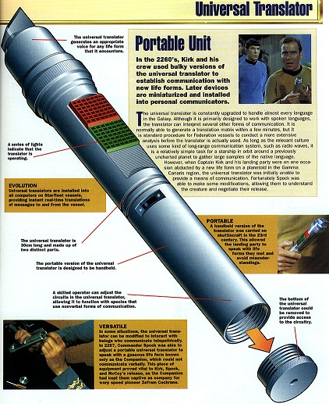
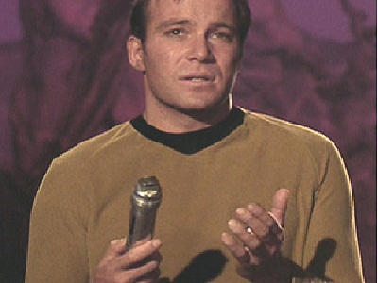
人类的梦想
《星际迷航》中的万能翻译器
星际联邦广泛使用了宇宙翻译器。宇宙翻译器可以将所有的已知语言翻译为听者所懂的语言，对其余的未知语言亦可通过对简短几句话的分析而进行转换。“进取号”能与整个银河系中的智能生物沟通，当遇到讲不同语言的外星生物时，他们会借助“宇宙翻译机”的帮助。

Slide 7
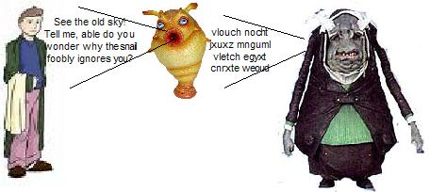
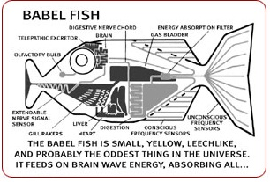
人类的梦想
《银河系漫游指南》中的巴别鱼
“巴别鱼，”《银河系漫游指南》轻轻朗读着，“体型很小，黄色，外形像水蛭，很可能是宇宙中最奇异的事物。它靠接收脑电波的能量为生….所有这些过程的实际效果就是，如果你把一条巴别鱼塞进耳朵，你就能立刻理解以任何形式的语言对你说的任何事情。你所听到的解码信号就是巴别鱼向你的思想提供的脑电波矩阵。”

Slide 8


人类的梦想
《神秘博士》中的TARDIS
Time and Relative Dimension in Space
TARDIS的翻译功能可以让靠近tardis的人自动把看到的听到的文字语言自动翻译为自己听得懂的语言

Slide 9

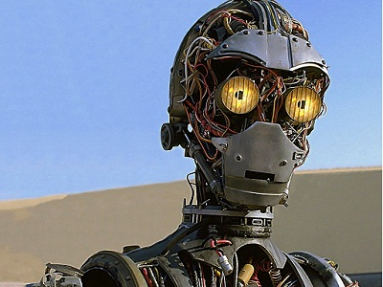
人类的梦想
《星球大战》中的斯瑞皮欧
作为一个神经质的、多愁善感的礼仪机器人，C-3PO经过多次的改造，他更成为一部精通六百万种沟通方式、懂得各地风俗的金色机器人。他不单只是像其他翻译机器人只是翻译，他也有人类的思想。

Slide 10

人类的梦想
《遥远星际》中的翻译微生物
在电视剧《遥远星际》中，John Crichton被注射了一种称为翻译微生物的细菌，该微生物起到了万能翻译器的作用。翻译微生物克隆了寄主的脑干，并翻译听到的任何语言，并将翻译后的结果直接传给寄主的大脑。该翻译微生物有的时候并不会翻译一些俚语，而只能将其做简单的字面翻译。

Slide 11
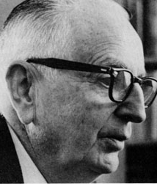
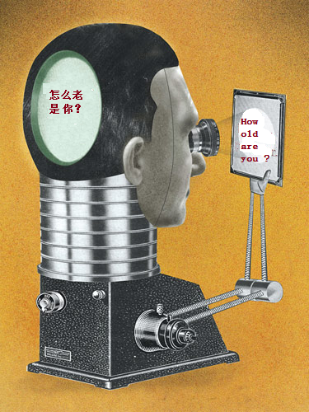
What is Machine Translation
It is very tempting to say that a book written in Chinese is simply a book written in English which was coded into the Chinese code. If we have useful methods for solving almost any cryptographic problem, may it not be that with proper interpretation we already have useful methods for translation?
-----------------------Warren Weaver, 1947

Slide 12

What is Machine Translation
Machine Translation
Machine translation is a sub-field of computational linguistics that investigates the use of software to translate text or speech from one language to another.

Slide 13
Roadmap of Machine Translation
Expectation
Google Translator 2006
Microsoft Translator 2007
SMT
1989
Neural MT
2014
Template Based Method
IBM-701
1954
Rule Based Method
TAUM-Meteo
1976
GIZA++ 2001
Phrase-based SMT 2004
Moses 2007
EBMT
1984
ALPAC
1966
Year
1947 1960 1970 1980 1990 2000 2010 2020

Slide 14
Introduction to Machine Translation
Background of MT
Methods of MT
Evaluation of MT

Slide 15
Machine Translation
Modern Machine Translation
In 1946, Warren Weaver firstly proposed the idea of translate the text from one language to another language
Rule Base Machine Translation
Based on rules designed by experts.
Example Based Machine Translation
Based on example sentence pairs.
Statistical Machine Translation
Based on statistical models trained with large corpus
Neural Machine Translation
Based on neural network trained with huge corpus
Notes:
机器翻译最早在1946年，沃伦·韦弗提出了使用机器将一种语言的文字转换为另一种语言的设想，并发表了著名的备忘录《翻译》，标志着现代机器翻译概念的正式形成。最开始是基于规则的机器翻译，基于规则的机器翻译就是首先由语言学家设计一些翻译的规则，计算机利用这些规则完成翻译转换。基于规则的翻译系统一方面需要大量的人力来编写规则，另一方面，规则之间的冲突又限制了这种方法的扩展能力。后来人们采用了基于实例的翻译方法，基于实例的方法方法维护一个实例库，新来一个源语言句子，则跟实例库里的实例进行匹配，找到最相似的实例，并基于该实例进行修改得到最终的翻译结果。随着互联网的快速发展，大规模的双语语料就可以从网络上挖掘得到，从而使得基于统计的方法变得可能。基于统计的方法极大的提高了翻译的质量。随着互联网的进一步发展，语料越来越多，计算能力也越来越强，从而使得复杂的模型，也就是伸进网络模型被应用到机器翻译中来。我们今天要说的就是神经机器翻译模型。

Slide 16
Rule Based Machine Translation
公司 里 的 员工 努力 工作 。
1
employees in the company worked hard .
公司/NN 里/LC 的/DEC 员工/NN 努力/AD 工作/VV 。/PU
4
2
worked/VBD
工作/VV
工作/VBD
employees/NNS
hard/RB
。/.
员工/NN
努力/AD
。/PU
员工/NNS
努力/RB
。/.
3
in/IN
里/LC
里/IN
company/NN
公司/NN
的/DEG
公司/NN
the/DT
Notes:
两种语言的转换
把一束花放在桌子上。元语言的句法，目标语言的转换：调整次序

Slide 17
Example based Machine Translation
Example Base
Source Example
Target Example
学校 里 的 学生 努力 学习 。
students in the school studied hard .
M$atched S^{′}$
T$arget T^{′}$
S$ource S$
T$ranslation T$
公司 里 的 员工 努力 工作 。
employees in the company worked hard .

Slide 18
Statistical Machine Translation
How to translate X to Y? → What is the translation probability of Y given X?
Search Space：the space of all the possible translation candidates.
Probability Model：How to define the probability of Y given X?
SMT = linguistic modeling + statistical decision theory
Herman Ney
Data Driven：Learn translation rules from large bilingual data with human defined features.
Statistic Driven：The translation candidate with maximum probability is the best translation.

Slide 19
Framework of SMT
Bilingual Data
Word Alignmetn
Decoding Algorithm
Parameter Tuning
Human Defined Feature
Rule Extraction
Dev Set
Source Sentence
Translation Model
SMT Decoder
Parameter Tuning
Monolingual Data
Language Model
Distortion Model
Target Translation

Slide 20
SMT Decoding：BTG
astronauts
coming from
France and Russia
reordering
X₁ X₂ ||| X₂ X₁
coming from
France and Russia
astronauts
飞行员 ||| astronauts
X₁ X₂ ||| X₁ X₂
coming from
France and Russia
法国 和 俄罗斯 ||| France and Russia
来自
法国 和 俄罗斯
的
飞行员
来自 ||| coming from

Slide 21
SMT Decoding：Hiero
astronauts
coming from
France
and
Russia
reordering
coming from
France
and
Russia
X₂ X₁
astronauts
X₁ 的 X₂ ||| X₂ X₁
飞行员 ||| astronauts
coming from X₁
France
and
Russia
来自 X₁ ||| coming from X₁
X₁ 和 X₂ ||| X₁ and X₂
France
X₁ and X₂
Russia
俄罗斯 ||| Russia
来自
法国
和
俄罗斯
的
飞行员
法国 ||| France

Slide 22
Neural Machine Translation
Still a statistical method
Try to model the translation probability of Y given X.
Much larger search space
Translation candidates are all the sequences of the target words.
No need human defined features
No translation model, language model and distortion model.
Will be introduced in detail later.

Slide 23
Introduction to Machine Translation
Background of MT
Methods of MT
Evaluation of MT

Slide 24
Evaluation of Machine Translation
Human Evaluation：信达雅
信达： fidelity
I cannot agree with you more. → 我不能同意你更多。
雅： fluency
How are you ? → 怎么是你？
How old are you ? → 怎么老是你？
Hight Cost
Automatic Evaluation
Compare the translation with the reference
N-gram similarity-based methods
NIST
BLEU
….
Convenient but may not be consistent with human preference
Reference (human) translation: The U.S. island of Guam is maintaining a high state of alert after the Guam airport and its offices both received an e-mail from someone calling himself the Saudi Arabian Osama bin Laden and threatening a biological/chemical attack against public places such as the airport .
Machine translation: The American [?] international airport and its the office all receives one calls self the sand Arab rich business [?] and so on electronic mail , which sends out ; The threat will be able after public place and so on the airport to start the biochemistry attack , [?] highly alerts after the maintenance.

Slide 25
Evaluation of Machine Translation: BLEU
N-gram precision (score is between 0 & 1)
What percentage of machine n-grams can be found in the reference translation?
An n-gram is a sequence of n words.
Brevity penalty
Can’t just type out single word “the” (precision 1.0!)
Amazingly hard to “game” the system (i.e., find a way to change machine output so that BLEU goes up, but quality doesn’t)
Papineni, et al. BLEU: a Method for Automatic Evaluation of Machine Translation. ACL, 2002

Slide 26
Evaluation of Machine Translation: BLEU
Example:
Reference: “the Iraqi weapons are to be handed over to the army within two weeks”
MT output: “in two weeks Iraq’s weapons will give army”
BLEU metric:
1-gram precision 4/8
2-gram precision: 1/7
3-gram precision: 0/6
4-gram precision: 0/5
BLEU score = 0

Slide 27
Evaluation of Machine Translation: BLEU
Example:
Reference1: “the Iraqi weapons are to be handed over to the army within two weeks”
Reference2: “the Iraqi weapons will be surrendered to the army in two weeks”
MT output: “ the the the the”
Clipping precision counts:
Precision count for “the” is clipped at 2: max count of the word in any reference.
Modified unigram score will be 2/4

Slide 28
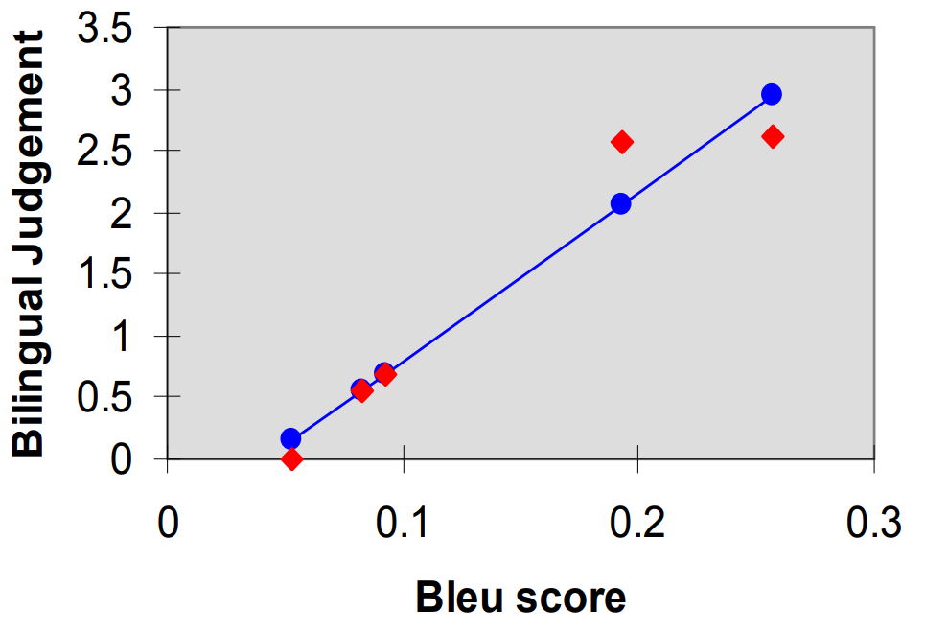
Evaluation of Machine Translation: BLEU
BLEU vs The Human Evaluation
BLEU tends to be high correlated with human judgments when the translation quality is low.
Correlation may be not high when the translation quality is good enough.
Papineni et al., 2002

Slide 29
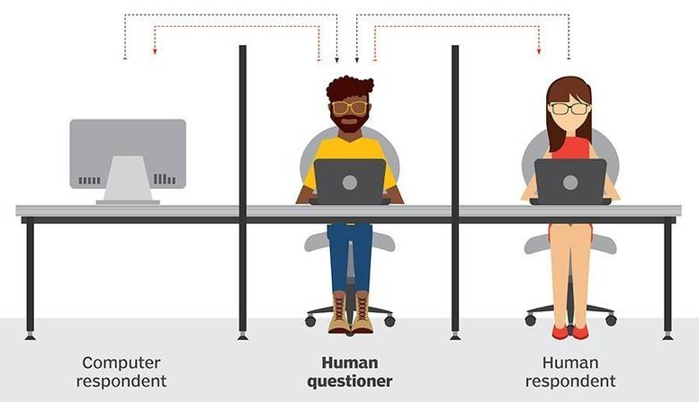
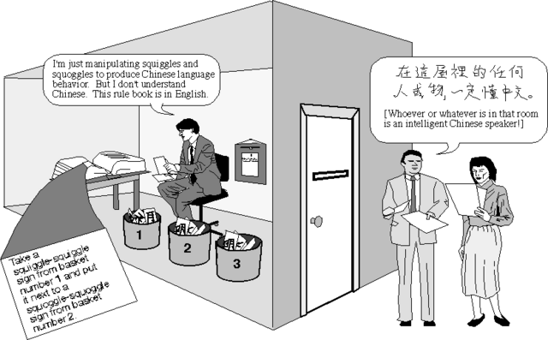
Weak AI: Turing Test vs Chinese Room
http://www.perspecsnews.com/read/tech/HJxOL8vHAM/HkxiJYKBRf
http://cognitivephilosophy.net/consciousness/human-cognition-and-the-chinese-room/

Slide 30
Neural Machine Translation

Slide 31
Neural Machine Translation
Recurrent Neural Networks
Naïve Neural Machine Translation
RNN-based NMT
Transformer-based NMT
NMT Training
Notes:
我会首先简单的介绍一下神经机器翻译模型的基本概念和方法，然后介绍一下我们最新的两个数据增强的工作。

Slide 32
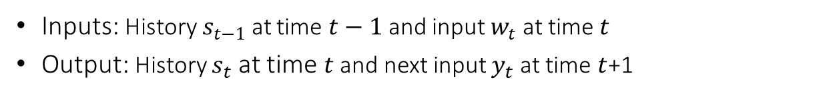
Recurrent Neural Network
Inputs: History $s_{t−1}$ at time $t−1$and input $w_{t}$ at time $t$
Output: History $s_{t}$ at time $t$and next input $y_{t}$ at time $t$+1
$$p(on|the cat sat)$$
$$h_{t−1}: \text{the} \text{cat}$$
$$y_{t}$$
Predicted next word (Probability distribution over all possible words)
Previous
hidden state
$$V$$
$$h_{t}$$
$$U$$
$$h_{t}$$
$h_{t}$: the cat sat
$$W$$
Current hidden state
Current input
$$x_{t−1}$$
$x_{t}:$ sat
Notes:
With language model

Slide 33
Unfolded RNN
$$\text{the}$$
$$\text{cat}$$
$$\text{sat}$$
$$\text{on}$$
$$\text{the}$$
$$\text{mat}$$
</s>
$$y_{t}$$
$$y_{1}$$
$$y_{2}$$
$$y_{3}$$
$$y_{4}$$
$$y_{5}$$
$$y_{5}$$
$$y_{6}$$
$$h_{t}$$
$$h_{0}$$
$$h_{1}$$
$$h_{2}$$
$$h_{3}$$
$$h_{4}$$
$$h_{5}$$
$$h_{6}$$
$$h_{7}$$
$$x_{t−1}$$
$$x_{0}$$
$$x_{1}$$
$$x_{2}$$
$$x_{3}$$
$$x_{4}$$
$$x_{5}$$
$$x_{6}$$
<s>
$$\text{the}$$
$$\text{cat}$$
$$\text{sat}$$
$$\text{on}$$
$$\text{the}$$
$$\text{mat}$$
RNN
Unfolded RNN for Language Modeling

Slide 34
Vanishing Gradient Problem
$$y_{1}$$
$$y_{2}$$
$$y_{t−1}$$
$$y_{t}$$
$$V$$
$$h_{out,1}$$
$$V$$
$$h_{out,2}$$
$$V$$
$$h_{out,t−1}$$
$$V$$
$$h_{out,t}$$
$$h_{1}$$
$$U$$
$$h_{2}$$
…
$$h_{t−1}$$
$$U$$
$$h_{t}$$
$$W$$
$$h_{in,1}$$
$$W$$
$$h_{in,2}$$
$$W$$
$$h_{in,t−1}$$
$$W$$
$$h_{in,t}$$
$$x_{0}$$
$$x_{1}$$
$$x_{t−2}$$
$$x_{t−1}$$
$$δ_{in,1}=δ_{out,t}×\frac{∂h_{out,t}}{∂h_{in,t}}×\frac{∂h_{in,t}}{∂h_{out,t−1}}×\frac{∂h_{out,t−1}}{∂h_{in,t−1}}×…×\frac{∂h_{in, 2}}{∂h_{out,1}}×\frac{∂h_{out,1}}{∂h_{in,1}}$$

Slide 35
LSTM: Long Short Term Memory
Input：Does $x^{(t)}$ matter?
Output/Exposure：
How much $c^{(t)}$ should be exposed?
$$h^{(t−1)}$$
$$U^{(i)}$$
$$h^{(t−1)}$$
$$i^{(t)}=σ(W^{\left(i\right)}x^{\left(t\right)}+U^{(i)}h^{(t−1)})$$
$$σ$$
$$U^{(o)}$$
$$σ$$
$$f^{(t)}=σ(W^{\left(f\right)}x^{\left(t\right)}+U^{(f)}h^{(t−1)})$$
$$x^{(t)}$$
$$W^{(i)}$$
$$x^{(t)}$$
$$i^{(t)}$$
$$o^{(t)}$$
$$W^{(o)}$$
$$o^{(t)}=σ(W^{\left(o\right)}x^{\left(t\right)}+U^{(o)}h^{(t−1)})$$
New Memory：Compute new memory?
$${\tilde{c}}^{(t)}=tanh(W^{\left(c\right)}x^{\left(t\right)}+U^{(c)}h^{(t−1)})$$
$$h^{(t−1)}$$
$$U^{(c)}$$
$$c^{(t)}=f^{\left(t\right)}°{\tilde{c}}^{\left(t−1\right)}+i^{\left(t\right)}°{\tilde{c}}^{(t)}$$
$$x^{(t)}$$
$$tanh$$
$$h^{(t)}=o^{\left(t\right)}°tanh(c^{\left(t\right)})$$
$$W^{(c)}$$
$${\tilde{c}}^{(t)}$$
$$c^{(t)}$$
$$+$$
$$tanh$$
$$h^{(t)}$$
$$c^{(t−1)}$$
Output Gate
Forget：Should $c^{(t−1)}$ be forgotten?
Forget Gate
$$h^{(t−1)}$$
$$U^{(f)}$$
$$σ$$
Input Gate
$$x^{(t)}$$
$$W^{(f)}$$
$$f^{(t)}$$
Sutskever, et al. Sequence to sequence learning with neural networks. NIPS, 2014

Slide 36
GRU: Gated Recurrent Unit
$$z^{(t)}=σ(W^{\left(z\right)}x^{\left(t\right)}+U^{(z)}h^{(t−1)})$$
Reset：Include $h^{(t−1)}$ in new memory?
Update：How much $h^{(t−1)}$ in next state?
$$r^{(t)}=σ(W^{\left(r\right)}x^{\left(t\right)}+U^{(r)}h^{(t−1)})$$
$$h^{(t−1)}$$
$$U^{(r)}$$
$$h^{(t−1)}$$
$$U^{(z)}$$
$${\tilde{h}}^{(t)}=tanh(r^{\left(t\right)}°Uh^{\left(t−1\right)}+Wx^{(t)})$$
$$σ$$
$$x^{(t)}$$
$$σ$$
$$x^{(t)}$$
$$W^{(r)}$$
$$W^{(z)}$$
$$h^{(t)}=\left(1−z^{\left(t\right)}\right)°{\tilde{h}}^{\left(t\right)}+z^{\left(t\right)}{°h}^{\left(t−1\right)}$$
$$r^{(t)}$$
$$z^{(t)}$$
$$not$$
$$h^{(t−1)}$$
$$U$$
$$h^{(t−1)}$$
$$tanh$$
$${\tilde{h}}^{(t)}$$
$$+$$
$$x^{(t)}$$
$$W$$
Reset Gate
$$h^{(t)}$$
New memory：compute new memory based on current word input $x^{(t)}$ and potentially${ h}^{(t−1)}$
Update Gate
Bahdanau, et al. Neural Machine Translation by Jointly Learning to Align and Translate. ICLR, 2015

Slide 37
Neural Machine Translation
Recurrent Neural Networks
Naïve Neural Machine Translation
RNN-based NMT
Transformer-based NMT
NMT Training
Notes:
我会首先简单的介绍一下神经机器翻译模型的基本概念和方法，然后介绍一下我们最新的两个数据增强的工作。

Slide 38
Naive Neural Machine Translation (1)
$$经济$$
$$发展$$
$$\text{变}$$
$$慢$$
NULL
在
$$\text{近}$$
$$几年$$
。
Economic growth has slowed down in recent years .

Slide 39
Naive Neural Machine Translation (2)
$$经济$$
$$发展$$
$$\text{变}$$
$$慢$$
NULL
在
$$\text{近}$$
$$几年$$
。
Economic growth has slowed down in recent years .

Slide 40
Naive Neural Machine Translation (3)
$$经济$$
$$发展$$
$$\text{变}$$
$$慢$$
NULL
在
$$\text{近}$$
$$几年$$
。
Economic growth has slowed down in recent years .

Slide 41
Naive Neural Machine Translation (4)
近$几年 ， 经济$ 发展 变 慢 了 。 </S>
Economic growth has slowed down in recent years .
Sutskever, et al. Sequence to sequence learning with neural networksslate. NIPS, 2014

Slide 42
Naive Neural Machine Translation (6)
近$几年 ， 经济$ 发展 变 慢 了 。 </S>
Economic growth has slowed down in recent years .

Slide 43
Naive Neural Machine Translation (5)
近$几年 ， 经济$ 发展 变 慢 了 。 </S>
Economic growth has slowed down in recent years .

Slide 44
Neural Machine Translation
Recurrent Neural Networks
Naïve Neural Machine Translation
RNN-based NMT
Transformer-based NMT
NMT Training
Notes:
我会首先简单的介绍一下神经机器翻译模型的基本概念和方法，然后介绍一下我们最新的两个数据增强的工作。

Slide 45
Encoder-Decoder for NMT
$f$=( )
近,
几年,
经济, 发展, 变, 慢, 了, .
Decoder
0.7
0.0
0.2
-0.2
0.9
-0.1
0.5
Encoder
$e$=(Economic, growth, has, slowed, down, in, recent, years,.)
Notes:
这儿显示的是神经网络串到串模型的框架，该框架包含一个编码模块和一个解码模块。
给定源语言句子Economic growth has slowed down in recent years. 编码模块首先将输入句子映射到一个语义空间中，得到一个实数向量，该语义空间中的实数向量应该能够包含输入句子的所有信息。基于该实数向量，解码模块将目标语言句子产生出来。那么如何将输入句子压缩成实数向量，以及如何基于这个实数向量产生目标语言句子呢？如果输入的句子和生成的句子长度是固定的，我们其实可以使用普通的前馈神经网络来实现。然而输入句子以及输出的句子的长度是不固定的，所以我们就需要使用一个特殊的神经网络，recurrent neural network，也就是循环神经网络。

Slide 46
Encoder-Decoder for NMT
近,
$f$=( )
几年,
经济, 发展, 变, 慢, 了, .
Word
Sample
$$u_{i}$$
Decoder
（1）
Recurrent
State
$$z_{i}$$
（2）
Decoder Recurrent Neural Network
（3）
Source
State
$$s_{i}$$
Encoder Recurrent Neural Network
Encoder
Source
Word
$$w_{i}$$
$e$=(Economic, growth, has, slowed, down, in, recent, years,.)
Bahdanau, et al. Neural Machine Translation by Jointly Learning to Align and Translate. ICLR, 2015
Notes:
基于循环神经网络的编码器解码器
两个部分：基于循环神经网络的编码器，基于循环神经网络的解码器
编码器：源语言词一个一个输入，没输入一个则将信息进行融合，最后包含所有词的信息，即整个句子的信息
解码器： 基于编码器得到的源语言句子表示，将目标语言句子里的词一个一个生成出来。
具体的，为了生成”几年”，三种信息：

Slide 47
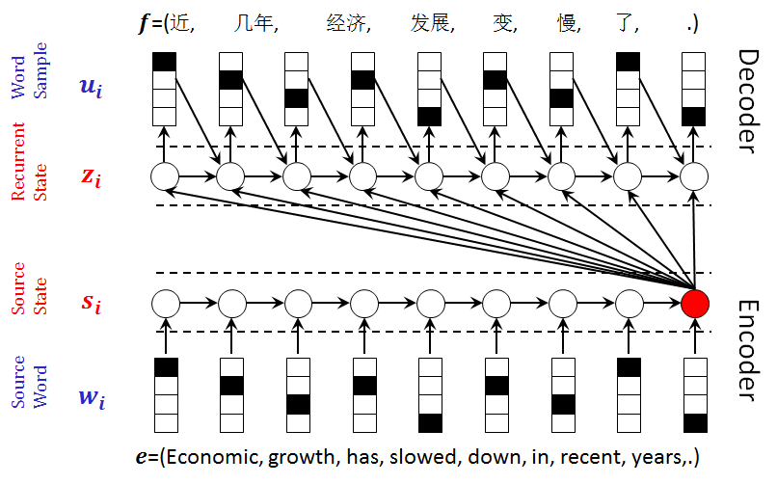
Motivation of Attention
NMT performs bad for long sentences
A long way from source to target
Only last hidden vector for decoding
Fixed-length hidden state is not enough
Solution
Connect the source and target directly
Use all the hidden states for decoding

Slide 48
Encoder-Decoder for NMT
近,
$f$=( )
几年,
,, 经济, 发展, 变, 慢, 了, .
Word
Sample
$$u_{i}$$
Decoder
Recurrent
State
$$z_{i}$$
Decoder Recurrent Neural Network
Source
State
$$s_{i}$$
Encoder Recurrent Neural Network
Encoder
Source
Word
$$w_{i}$$
$e$=(Economic, growth, has, slowed, down, in, recent, years, .)
Notes:
基于循环神经网络的编码器解码器
两个部分：基于循环神经网络的编码器，基于循环神经网络的解码器
编码器：源语言词一个一个输入，没输入一个则将信息进行融合，最后包含所有词的信息，即整个句子的信息
解码器： 基于编码器得到的源语言句子表示，将目标语言句子里的词一个一个生成出来。
具体的，为了生成”几年”，三种信息：

Slide 49
Encoder-Decoder for NMT
近,
$f$=( )
几年,
,, 经济, 发展, 变, 慢, 了, .
Word
Sample
$$u_{i}$$
Decoder
Recurrent
State
$$z_{i}$$
Decoder Recurrent Neural Network
?
?
?
?
?
?
?
?
?
Source
State
$$s_{i}$$
Encoder Recurrent Neural Network
Encoder
Source
Word
$$w_{i}$$
$e$=(Economic, growth, has, slowed, down, in, recent, years, .)
Notes:
基于循环神经网络的编码器解码器
两个部分：基于循环神经网络的编码器，基于循环神经网络的解码器
编码器：源语言词一个一个输入，没输入一个则将信息进行融合，最后包含所有词的信息，即整个句子的信息
解码器： 基于编码器得到的源语言句子表示，将目标语言句子里的词一个一个生成出来。
具体的，为了生成”几年”，三种信息：

Slide 50
Encoder-Decoder for NMT
近,
$f$=( )
几年,
,, 经济, 发展, 变, 慢, 了, .
Word
Sample
$$u_{i}$$
Decoder
Recurrent
State
$$z_{i}$$
Decoder Recurrent Neural Network
$$⊕$$
Source
State
0.01
0.02
0.01
0.01
0.04
0.01
0.01
0.1
0.7
0. 1
$$s_{i}$$
Encoder Recurrent Neural Network
Encoder
Source
Word
$$w_{i}$$
$e$=(Economic, growth, has, slowed, down, in, recent, years, .)
Bahdanau, et al. Neural Machine Translation by Jointly Learning to Align and Translate. ICLR, 2015
Notes:
基于循环神经网络的编码器解码器
两个部分：基于循环神经网络的编码器，基于循环神经网络的解码器
编码器：源语言词一个一个输入，没输入一个则将信息进行融合，最后包含所有词的信息，即整个句子的信息
解码器： 基于编码器得到的源语言句子表示，将目标语言句子里的词一个一个生成出来。
具体的，为了生成”几年”，三种信息：

Slide 51
Attention based Encoder-Decoder
近,
$f$=( )
几年,
Word
Sample
$$u_{i}$$
Decoder
Recurrent
State
$$z_{i}$$
$$⨀$$
Attention
Weight
Attention
Internal
Semantic
$$c_{i}$$
$$⊕$$
Left-to-Right
Source
Vectors
$$h_{j}$$
Encoder
Right-to-Left
$e$=(Economic, growth, has, slowed, down, in, recent, years,.)
Bahdanau, et al. Neural Machine Translation by Jointly Learning to Align and Translate. ICLR, 2015
Notes:
两个主要的改动： 双向的循环神经网络编码器， 注意力机制
双向的编码器具体的xxx，每个隐含向量包含了整个句子的上下文信息。
注意力机制通过计算相似度得到每个隐含向量的权重，通过权重将隐含向量相加，得到了考虑了解码器当前状态的并且更适合生成当前目标语言词的上下文向量。 举例

Slide 52
Attention based Encoder-Decoder
近,
$f$=( )
几年,
经济,
发展, 变, 慢, 了, .
Word
Sample
$$u_{i}$$
Decoder
Recurrent
State
$$z_{i}$$
$$⨀$$
Attention
Weight
Attention
Internal
Semantic
$$c_{i}$$
$$⊕$$
Source
Vectors
$$h_{j}$$
Encoder
$e$=(Economic, growth, has, slowed, down, in, recent, years,.)
Bahdanau, et al. Neural Machine Translation by Jointly Learning to Align and Translate. ICLR, 2015
Notes:
1.类似的为了生成第三个词，需要xxxx
2. 通过注意力机制，一方面使用了全部的编码器的隐含向量，另一方面将源语言词和目标语言词的距离通过注意力机制直接连接起来，从而使得信息和梯度的传递更为高效。

Slide 53
Attention in Detail
Compute matching score
Normalize to be probability
Sum all the source hidden states
Previous decoder state
Bi-directional Encoder States
$$e_{j}=\left\{\begin{matrix}z^{T}h_{j} dot \\ z^{T}{Wh}_{j} general \\ V^{T}tanh\left(W\left[z;h_{j}\right]\right) concat\end{matrix}\right.$$
$$z$$
$$h_{j}$$
Linear Mapping
Matching Function
$$a_{j}=e_{j}−log⁡(\sum_{j′}{exp⁡(e_{j′})})$$
$$e_{0}$$
$$c=\sum_{j}{exp⁡(a_{j})h_{j}}$$
Bahdanau, et al. Neural Machine Translation by Jointly Learning to Align and Translate. ICLR, 2015
Notes:
基于注意力网络的上下文向量的计算包括三部分。
第一部分计算编码器隐含向量和解码器隐含向量的相似程度，相似函数有xxx

Slide 54
Attention in Detail
Compute matching score
Normalize to be probability
Sum all the source hidden states
$$e_{j}=\left\{\begin{matrix}z^{T}h_{j} dot \\ z^{T}{Wh}_{j} general \\ V^{T}tanh\left(W\left[z;h_{j}\right]\right) concat\end{matrix}\right.$$
$$h_{j}$$
Linear Mapping
$c$ is use as an input of the decoder RNN
$$a_{0}$$
$$a_{1}$$
$$a_{j}=e_{j}−log⁡(\sum_{j′}{exp⁡(e_{j′})})$$
$$c$$
$$a_{2}$$
$$a_{3}$$
$$a_{4}$$
$$c=\sum_{j}{exp⁡(a_{j})h_{j}}$$
$$a_{5}$$
Bahdanau, et al. Neural Machine Translation by Jointly Learning to Align and Translate. ICLR, 2015
Notes:
1.第二部分就是将这个相似度得分通过softmax函数归一化为一个概率
2. 第三部分，对编码器所有的隐含向量进行加权平均得到基于注意力机制的上下文向量。

Slide 55
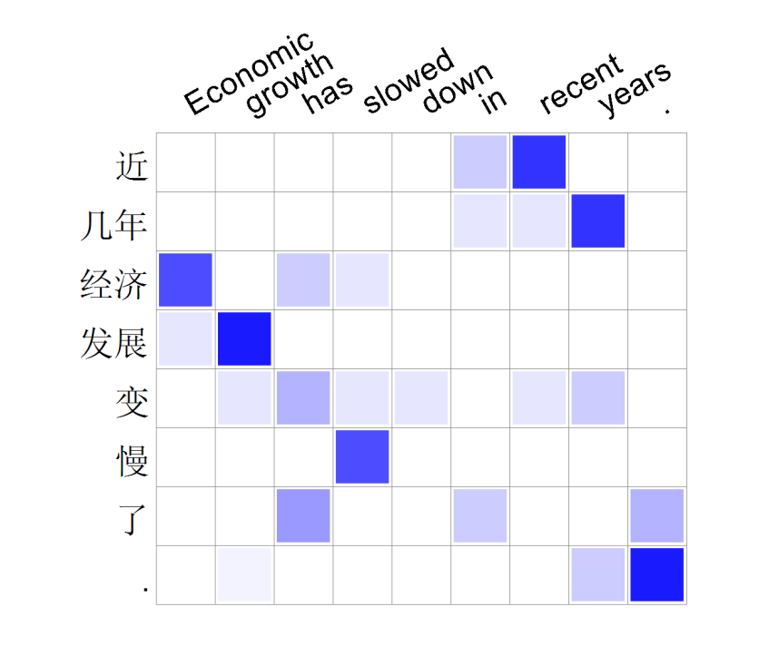
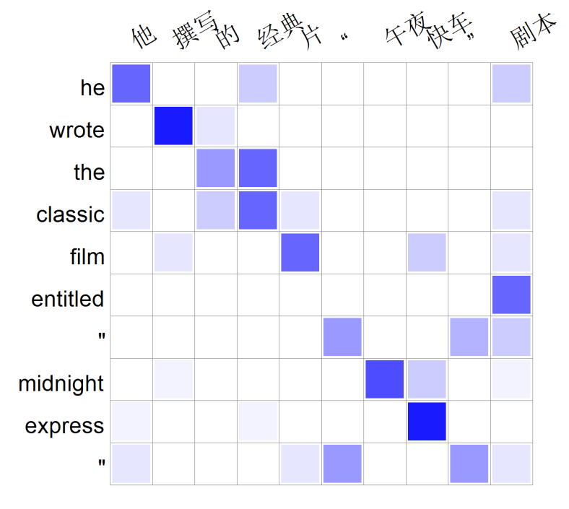
Case Study of Attention

Slide 56
Neural Machine Translation
Recurrent Neural Networks
Naïve Neural Machine Translation
RNN-based NMT
Transformer-based NMT
NMT Training
Notes:
我会首先简单的介绍一下神经机器翻译模型的基本概念和方法，然后介绍一下我们最新的两个数据增强的工作。

Slide 57
Merits and Demerits of RNN-based NMT
Merits
Not only the last one but all the source hidden states are used.
To generate the target word, the corresponding source word can receive more attention.
Source and target hidden states are directly connected.
Demerits
Hard to model long dependency using RNNs.
Can only pay attention to the source hidden states from one perspective using the one-head attention mechanism.
近 几年 经济 发展 变 慢 了 . </S>
Decoder
Attention
Attention
Weight
$$⨀$$
$$⊕$$
Encoder
economic growth has slowed down in recent years .
Bahdanau, et al. Neural machine translation by jointly learning to align and translate. arXiv, 2014

Slide 58
Transformer
近/0 几年/1 ,/2 经济/3 发展/4
Decoder
Self-attention is used to replace the RNNs in the encoder and decoder.
Words with a long distance can be connected directly with self-attention.
Multi-head attention is used to replace the one-head attention.
Context information from different aspects can be modeled with multi-head attention.
Attention
$$⊕$$
Encoder
economic/0 growth/1 has/2 slowed/3 down/4 in/5 recent/6 years/7
Vaswani, et al. Attention is all you need. NeurIPS, 2017

Slide 59
Transformer
Softmax
近/0 几年/1 ,/2 经济/3 发展/4
Linear Layer
Layer Norm
Decoder
$$⊕$$
FFN
Layer Norm
Layer Norm
$$⊕$$
Attention
$$⊕$$
$$⊕$$
Multi-head Attention
FFN
Layer Norm
Layer Norm
$$⊕$$
$$⊕$$
Encoder
Multi-head Self Attention
Masked Multi-head Self Attention
N
N
$$⊕$$
$$⊕$$
economic/0 growth/1 has/2 slowed/3 down/4 in/5 recent/6 years/7
Source Position Embedding
Source Word Embedding
Target Position Embedding
Target Word Embedding

Slide 60
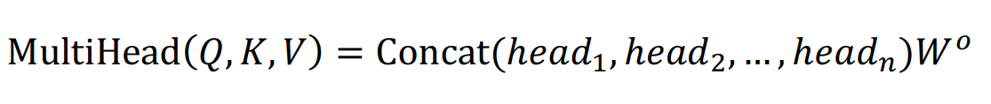
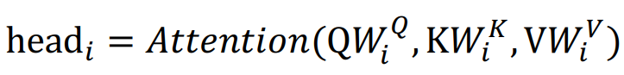
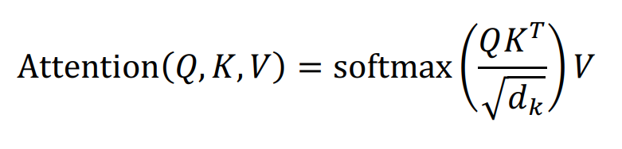
Transformer: Multi-Head Self-Attention
Given the current hidden state as query $Q$, all the hidden states as $K$ and $V$, multi-head self-attention is calculated as:
Scaled dot product attention is calculated as:
Liner
Concatenate
Scaled Dot Product Attention
$$n$$
Linear
Linear
Linear
$$Q$$
$$K$$
$$V$$
Weighted Sum
Softmax
$d_{k}$ is the vector size of $K$. $\sqrt{d_{k}}$ is the temperature factor. the larger $\sqrt{d_{k}}$, the more even distribution.
$$\sqrt{d_{k}}$$
$$⊘$$
$$⊙$$
$$Q$$
$$K$$
$$V$$

Slide 61
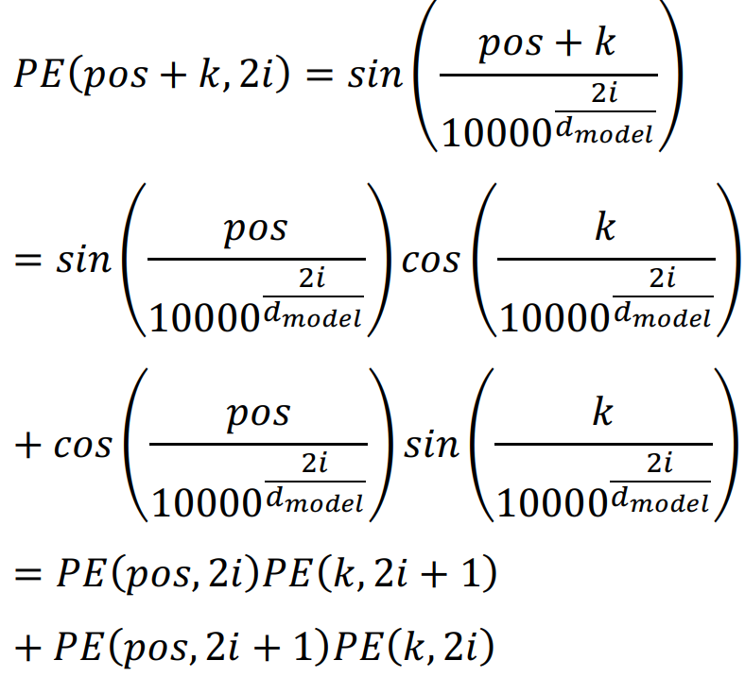
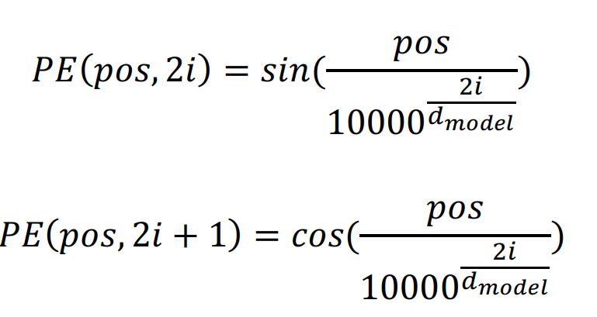
Transformer: Position Embedding
Why Position Embedding?
No recurrent structure in the encoder and decoder network.
Cannot model the ordering information of words in a sentence.
Definition of Position Embedding

Slide 62
Neural Machine Translation
Recurrent Neural Networks
Naïve Neural Machine Translation
RNN-based NMT
Transformer-based NMT
NMT Training
Notes:
我会首先简单的介绍一下神经机器翻译模型的基本概念和方法，然后介绍一下我们最新的两个数据增强的工作。

Slide 63
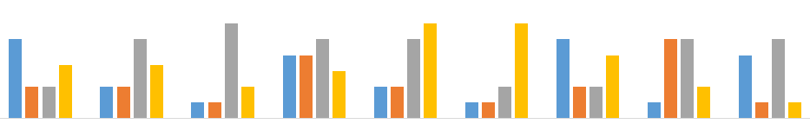
Cross Entropy Training of NMT
Minimize This !
Given the input sentence $x=(x_{1},x_{2},…,x_{|x|})$ and the output sentence $y=(y_{1},y_{2},…,y_{|y|})$, the likelihood of the conditional probability is:
The loss is defined as:
SUM(-log(.7) -log(.5) -log(.8) -log(.6) -log(.4) -log(.1) -log(.8) -log(.3) -log(.9)) = 2.07
-log(.7) -log(.5) -log(.8) -log(.6) -log(.4) -log(.1) -log(.8) -log(.3) -log(.9)
.7 .5 .8 .6 .4 .1 .8 .3 .9
$$p_{θ}\left(y|x\right)=\prod_{i=1}^{|y|}{p_{θ}(}y_{i}|y_{i−1},…,y_{1},x)$$
近 几年 经济 发展 变 慢 了 . </S>
$$⊕$$
$$LOSS=\sum_{\left(x,y\right)∈T}{−\log{p_{θ}\left(y|x\right)}}$$
$$=\sum_{\left(x,y\right)∈T}{\sum_{i=1}^{|y|}{−\log{p_{θ}(y_{i}|y_{i−1},…,y_{1},x)}}}$$
economic growth has slowed down in recent years .
Notes:
The supervised learning for sequence to sequence tasks (for example machine translation) is to maximize the generation probability of the ground true target sentence conditioned on the given source sentence.

Slide 64
SGD (Stochastic Gradient Descent )
Perform a parameter update for each training example $x^{\left(i\right)}$and label $y^{(i)}$, where $θ$is the parameter to be updated and $η$is learning rate.
$$θ=θ−η·∇_{θ }J(θ;x^{\left(i\right)};y^{(i)})$$
When using mini-batch, $∇_{θ }J(θ$) will be the average of gradient w.r.t $θ$over batches.
$$θ=θ−η·∇_{θ }J(θ)$$
Other adaptive learning rate training methods: Adgrad, Adadelta, Adam.

Slide 65
Low Resource Neural Machine Translation

Slide 66
Low Resource NMT
Monolingual Data
Human Labeling
Another Language
Low Resource NMT
Pre-trained Model
Multi-Task Multilingual

Slide 67
Leverage Monolingual Data for Low Resource NMT
Shallow/Deep Fusion with Language Model
Autoencoder Method with Monolingual Data
Dual Learning for Neural Machine Translation
Back-Translation with Target Monolingual Data
Joint Training for S2T and T2S Models

Slide 68
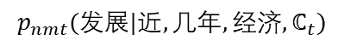
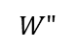
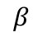
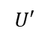
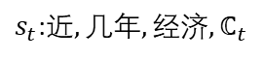
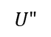
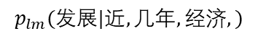
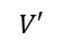
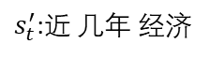
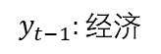
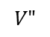
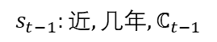
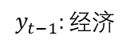
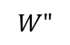
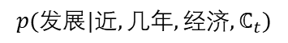
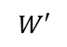
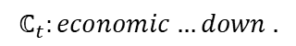
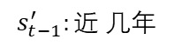
Shallow Fusion with Language Model
$$p(发展|近,几年,经济,ℂ_{t})$$
$$β$$
$$p_{nmt}(发展|近,几年,经济,ℂ_{t})$$
$$p_{lm}(发展|近,几年,经济,)$$
$$s_{t−1}:近,几年,ℂ_{t−1}$$
$$V′$$
$$s_{t−1}^{′}:近 几年$$
$$V"$$
$$U′$$
$$U"$$
$s_{t}^{′}$:$近 几年 经济$
$s_{t}$:$近,几年,经济,ℂ_{t}$
$$W′$$
$$W"$$
$$W"$$
$$y_{t−1}:经济$$
$$ℂ_{t}:economic…down .$$
$$y_{t−1}:经济$$
Gulcehre et al., On Using Monolingual Corpora in Neural Machine Translation. arxiv, 2015.

Slide 69
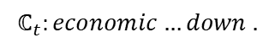
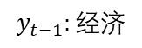
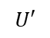
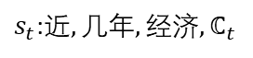
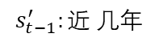
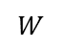
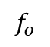
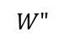
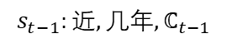
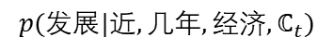
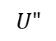
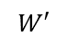

Deep Fusion with Language Model
$$p(发展|近,几年,经济,ℂ_{t})$$
$$W$$
$$f_{o}$$
$$ℂ_{t}:economic…down .$$
$$y_{t−1}:经济$$
$$s_{t−1}:近,几年,ℂ_{t−1}$$
$$s_{t−1}^{′}:近 几年$$
$$U′$$
$$U"$$
$s_{t}^{′}$:$近 几年 经济$
$s_{t}$:$近,几年,经济,ℂ_{t}$
$$W′$$
$$W"$$
$$W"$$
$$y_{t−1}:经济$$
$$ℂ_{t}:economic…down .$$
$$y_{t−1}:经济$$
Gulcehre et al., On Using Monolingual Corpora in Neural Machine Translation. arxiv, 2015.

Slide 70


Experiments for Shallow/Deep Fusion of LM
OpenMT15:Zh-En
(Bilingual: 436K sentence pairs)
(Monolingual: Gigaword)
(SMS/CHAT: chat data,
CTS: conversational telephone speech)
WMT15:De-En, Cs-En
(Bilingual/De-En: 4.1M sentence pairs)
(Bilingual/Cs-En : 12.1M sentence pairs)
(Monolingual: Gigaword)
Gulcehre et al., On Using Monolingual Corpora in Neural Machine Translation. arxiv, 2015.

Slide 71
Leverage Monolingual Data for Low Resource NMT
Shallow/Deep Fusion with Language Model
Autoencoder Method with Monolingual Data
Dual Learning for Neural Machine Translation
Back-Translation with Target Monolingual Data
Joint Training for S2T and T2S Models

Slide 72




Autoencoder Method with Monolingual Data
Source monolingual corpus:
布什 与 沙龙 举行 了 会谈
Decoder
Bush held a talk with Sharon
Encoder
Encoder
Decoder
布什 与 沙龙 举行 了 会谈
Cheng et al., Semi-Supervised Learning for Neural Machine Translation. ACL, 2016.

Slide 73




Autoencoder Method with Monolingual Data
Target monolingual corpus:
Bush held a talk with Sharon
Decoder
布什 与 沙龙 举行 了 会谈
Encoder
Encoder
Decoder
Bush held a talk with Sharon
Cheng et al., Semi-Supervised Learning for Neural Machine Translation. ACL, 2016.

Slide 74


Autoencoder Method with Monolingual Data
Intractable due to the exponential search space.
Top-k list used as a substitution.
Cheng et al., Semi-Supervised Learning for Neural Machine Translation. ACL, 2016.

Slide 75

Autoencoder Method with Monolingual Data
Cheng et al., Semi-Supervised Learning for Neural Machine Translation. ACL, 2016.

Slide 76
Leverage Monolingual Data for Low Resource NMT
Shallow/Deep Fusion with Language Model
Autoencoder Method with Monolingual Data
Dual Learning for Neural Machine Translation
Back-Translation with Target Monolingual Data
Joint Training for S2T and T2S Models

Slide 77






Dual Learning for Neural Machine Translation
Source Data
Bilingual Data
Sampling
Synthetic Data
Reward
LM
He et al., Dual Learning for Machine Translation. NIPS, 2016.

Slide 78



Dual Learning for Neural Machine Translation
Target Data
Bilingual Data
Sampling
Synthetic Data
Reward
LM
He et al., Dual Learning for Machine Translation. NIPS, 2016.

Slide 79

Dual Learning for Neural Machine Translation
He et al., Dual Learning for Machine Translation. NIPS, 2016.

Slide 80
Leverage Monolingual Data for Low Resource NMT
Shallow/Deep Fusion with Language Model
Autoencoder Method with Monolingual Data
Dual Learning for Neural Machine Translation
Back-Translation with Target Monolingual Data
Joint Training for S2T and T2S Models

Slide 81







Back-Translation with Target Monolingual Data
$x:$when the final whistle sounded, the Italian capital of rome boiled .
$y:$当 终场 哨声 响起 ， 意大利 首都 罗马 沸腾 了 。
Bilingual Training Data $(x,y)$
$${NMT}_{x→y}$$
$\tilde{y}:$当 终场 哨声 响起 ， 意大利 首都 罗马 沸腾 了 。
Target Sentences $\tilde{y}$
Dummy Sentence Pair ($\tilde{x}$, $\tilde{y}$)
$\tilde{x}$: <null>
$\tilde{y}:$当 终场 哨声 响起 ， 意大利 首都 罗马 沸腾 了 。
Sennrich et al., Improving Neural Machine Translation Models with Monolingual Data. ACL, 2016.
Notes:
双语数据， 目标语言单语数据
两个翻译系统， 源语言到目标语言的翻译系统，目标语言到源语言的系统
使用目标语言到源语言的系统对单语数据进行翻译，构造伪双语数据
存在的问题： 1. 2 .3.

Slide 82





Back-Translation with Target Monolingual Data
$x:$when the final whistle sounded, the Italian capital of rome boiled .
$y:$当 终场 哨声 响起 ， 意大利 首都 罗马 沸腾 了 。
Bilingual Training Data $(x,y)$
$${NMT}_{y→x}$$
$${NMT}_{x→y}$$
$\tilde{y}:$当 终场 哨声 响起 ， 意大利 首都 罗马 沸腾 了 。
Target Sentences $\tilde{y}$
Generated Training Data $(\tilde{x},\tilde{y})$
$\tilde{x}$: the Italian capital of rome boiled with rome.
$\tilde{y}:$当 终场 哨声 响起 ， 意大利 首都 罗马 沸腾 了 。
$\tilde{x}$: the Italian capital of rome boiled with rome.
Sennrich et al., Improving Neural Machine Translation Models with Monolingual Data. ACL, 2016.
Notes:
双语数据， 目标语言单语数据
两个翻译系统， 源语言到目标语言的翻译系统，目标语言到源语言的系统
使用目标语言到源语言的系统对单语数据进行翻译，构造伪双语数据
存在的问题： 1. 2 .3.

Slide 83

Back-Translation with Target Monolingual Data
Sennrich et al., Improving Neural Machine Translation Models with Monolingual Data. ACL, 2016.

Slide 84
Leverage Monolingual Data for Low Resource NMT
Shallow/Deep Fusion with Language Model
Autoencoder Method with Monolingual Data
Dual Learning for Neural Machine Translation
Back-Translation with Target Monolingual Data
Joint Training for S2T and T2S Models

Slide 85




Joint Training for S2T and T2S Models
Given parallel corpus $D={\left\{\left(x^{\left(n\right)},y^{\left(n\right)}\right)\right\}}_{n=1}^{N}$ and monolingual corpus in target language $Y={\left\{y^{\left(t\right)}\right\}}_{t=1}^{T}$, the semi-supervised training objective as follows:
Introduce source translations as hidden states for monolingual target sentences
The equal condition is
Zhang et al., Joint Training for Neural Machine Translation Models with Monolingual Data. AAAI, 2018.
Notes:
给定双语数据和单语数据，我们把损失函数定义为，双语数据的翻译概率和单语数据的语言模型概率
我们在语言模型概率上引入了源语言作为隐含状态，并使用jensen不等式和变分的方法进行推导得到隐含状态的分布实际上是目标语言到源语言的翻译模型概率。
如果大家学过期望最大化，这就是一个简单的期望最大化的推导，隐含变量是源语言句子，观测值是目标语言句子。损失函数的第二项就是最大化观测值的概率，即，目标语言单语数据中句子的概率。

Slide 86
Joint Training for S2T and T2S Models
Target Data
Bilingual Data
Sampling
Synthetic Data
T2S Model
S2T Model
Zhang et al., Joint Training for Neural Machine Translation Models with Monolingual Data. AAAI, 2018.
Notes:
基于EM的公式推导，我们得到源语言到目标语言翻译模型参数的更新公式。
从更新公式我们可以看到，参数的更新使用了两部分的数据。 原始的双语数据（x^n, y^n），和一个使用目标语言到源语言翻译模型翻译目标语言单语数据得到的伪双语数据(x^t, y^t)。
由于伪双语数据是由目标语言到源语言翻译得到的，所以目标语言到源语言翻译模型的性能就很关键。我们下边讲如何使用类似的方法提高目标语言到源语言的翻译模型

Slide 87
Joint Training for S2T and T2S Models
Source Data
Bilingual Data
Sampling
Synthetic Data
S2T Model
T2S Model
Zhang et al., Joint Training for Neural Machine Translation Models with Monolingual Data. AAAI, 2018.
Notes:
同样，我们可以使用源语言的单语数据并将其语言模型概率添加到双语数据的翻译概率上，并使用类似的EM算法得到目标语言到源语言的翻译模型的参数更新公式。
参数的更新同样使用了两个数据， 原始的双语数据和基于源语言单语数据，经过源语言到目标语言的翻译模型翻译得到的伪双语数据。

Slide 88








Joint Training for S2T and T2S Models
Extend back-translation to paired one:
Jointly optimizing source-to-target NMT model $M_{x→y}$ and target-to-source NMT model $M_{y→x}$ with the help of monolingual data from both source language $X$ and target language $Y$
$$X=\left\{x^{\left(s\right)}\right\}$$
$$D=\left\{x^{\left(n\right)},y^{\left(n\right)} \right\}$$
$$Y=\left\{y^{\left(t\right)}\right\}$$
$$M_{x→y }$$
$$M_{y→x}$$
$$X^{′}=\left\{x^{\left(s\right)},y^{(s)}\right\}$$
$$Y^{′}=\left\{x^{\left(t\right)}, y^{(t)} \right\}$$
Zhang et al., Joint Training for Neural Machine Translation Models with Monolingual Data. AAAI, 2018.

Slide 89


Joint Training for S2T and T2S Models
Iteration 0: Pre-train two direction models $M_{x→y}^{0}$ and $M_{y→x}^{0}$ with bilingual data $D=\{x^{\left(n\right)},y^{(n)}\}$
Iteration 1: Two NMT systems based on $M_{x→y}^{0}$ and $M_{y→x}^{0}$ are used to translate monolingual data $X=\{x^{(s)}\}$ and $Y=\{y^{(t)}\}$; two synthetic training data sets $X^{′}$ and $Y′$ combined with bilingual data $D$ are used to train $M_{x→y}^{1}$ and $M_{y→x}^{1}$ respectively.
Iteration 2: Repeat the above process
….
Zhang et al., Joint Training for Neural Machine Translation Models with Monolingual Data. AAAI, 2018.

Slide 90

Joint Training for S2T and T2S Models
Zhang et al., Joint Training for Neural Machine Translation Models with Monolingual Data. AAAI, 2018.
Notes:
We conduct experiments on the NIST English to Chinese and WMT English to german translation tasks. We can find that, the joint training can significantly improve the translation performance.

Slide 91
Low Resource NMT
Monolingual Data
Human Labeling
Another Language
Low Resource NMT
Pre-trained Model
Multi-Task Multilingual

Slide 92
Tri-Language Learning for Low Resource NMT
Teacher-Student Framework for Zero-Resource NMT
Triangular Architecture for Rare Language NMT
Consistency by Agreement in Zero-shot NMT
Generalized Data Augmentation for Low-Resource Translation

Slide 93

Teacher-Student Framework for Zero-Resource NMT
Pivot-based Method
Teacher Student Method
Chen et al., A Teacher-Student Framework for Zero-Resource Neural Machine Translation. ACL, 2017.

Slide 94




Teacher-Student Framework for Zero-Resource NMT
Chen et al., A Teacher-Student Framework for Zero-Resource Neural Machine Translation. ACL, 2017.

Slide 95


Teacher-Student Framework for Zero-Resource NMT
Chen et al., A Teacher-Student Framework for Zero-Resource Neural Machine Translation. ACL, 2017.

Slide 96

Teacher-Student Framework for Zero-Resource NMT
Chen et al., A Teacher-Student Framework for Zero-Resource Neural Machine Translation. ACL, 2017.

Slide 97
Tri-Language Learning for Low Resource NMT
Teacher-Student Framework for Zero-Resource NMT
Triangular Architecture for Rare Language NMT
Consistency by Agreement in Zero-shot NMT
Generalized Data Augmentation for Low-Resource Translation

Slide 98








Triangular Architecture for Rare Language NMT
Problem
Large bilingual corpus $(X,Y)$ between rich languages $X$ and $Y$.
Small bilingual corpus $(X,Z)$ and $(Z,Y)$ between rare language $Z$ and rich languages $X$ and $Y$.
Method
Language $Z$ is used as a hidden space to translate a sentence from language $X$ to language $Y$, and from $Y$to $X$.
Small bilingual corpora are used to initialize$p\left(z | x\right),p\left(y | z\right),p\left(z | y\right)$ and $p\left(x | z\right)$.
EM training is leveraged for fine tuning.
$$p\left(y | x\right)=\sum_{z∈Z}{p\left(z | x\right)p(y|z)}$$
$$p\left(x | y\right)=\sum_{z∈Z}{p\left(z | y\right)p(x|z)}$$
$$X$$
$$Y$$
$X$: English
$Y$: French
$Z$: Hebrew
$$Z$$
Ren et al., Triangular Architecture for Rare Language Translation. ACL, 2018.

Slide 99




Triangular Architecture for Rare Language NMT
X→Z→Y
E:Find the lower bound
M:Maxmize the Expectation of y
E-Step of X→Z→Y:
Update $p(z|x）$using $p(z|y）$
M-Step of X→Z→Y:
Update $p(y|z）$using $p(z|x）$
E-Step of Y→Z→X:
Update $p(z|y）$using $p(z|x）$
M-Step of X→Z→Y:
Update $p(x|z）$using $p(z|y）$
…….
M:Maxmize the Expectation of x
E:Find the lower bound
X←Z←Y
Ren et al., Triangular Architecture for Rare Language Translation. ACL, 2018.

Slide 100
Triangular Architecture for Rare Language NMT
Experiment Setting: Single layer GRU-based NMT, with hidden size 512, embedding size 256.
Baseline
NMT: NMT system trained only with bilingual data.
PBSMT: Phrase based statistical machine translation system.
Comparison System
T-S: Teach student training method.
BackTrans: Back translation with monolingual data.
Data: IWSLT (EN-FR:7.9M, EN-HE:112.6k, FR-HE:116.3K, HE:512.5K)
+1.3
+1.4
+1.2
+1.6
Ren et al., Triangular Architecture for Rare Language Translation. ACL, 2018.
Notes:
\

Slide 101
Triangular Architecture for Rare Language NMT
Experiment Setting: Single layer GRU-based NMT, with hidden size 512, embedding size 256.
Baseline
NMT: NMT system trained only with bilingual data.
PBSMT: Phrase based statistical machine translation system.
Comparison System
T-S: Teach student training method.
BackTrans: Back translation with monolingual data.
Data: IWSLT (EN-FR:7.9M, EN-RO:467.3k, FR-RO:111.6K, RO:885.5K)
+1.5
+1.1
+1.2
+2.3
Ren et al., Triangular Architecture for Rare Language Translation. ACL, 2018.

Slide 102
Tri-Language Learning for Low Resource NMT
Teacher-Student Framework for Zero-Resource NMT
Triangular Architecture for Rare Language NMT
Consistency by Agreement in Zero-shot NMT
Generalized Data Augmentation for Low-Resource Translation

Slide 103


Consistency by Agreement in Zero-shot NMT
Motivation
The performance on zero-shot tasks is often unstable and significantly lags behind the supervised directions.
Traditional multilingual objective misses the terms that correspond to zero-shot models, and hence has no statistical guarantee for performance on zero-shot tasks
Method
Agreement-based learning:
Al-Shedivat and P. Parikh, Consistency by Agreement in Zero-shot Neural Machine Translation . NAACL, 2019.

Slide 104


Consistency by Agreement in Zero-shot NMT
Al-Shedivat and P. Parikh, Consistency by Agreement in Zero-shot Neural Machine Translation . NAACL, 2019.

Slide 105

Consistency by Agreement in Zero-shot NMT
Al-Shedivat and P. Parikh, Consistency by Agreement in Zero-shot Neural Machine Translation . NAACL, 2019.

Slide 106
Tri-Language Learning for Low Resource NMT
Teacher-Student Framework for Zero-Resource NMT
Triangular Architecture for Rare Language NMT
Consistency by Agreement in Zero-shot NMT
Generalized Data Augmentation for Low-Resource Translation

Slide 107



Generalized Data Augmentation for Low-Resource NMT
Data Available
$\{S_{LE},T_{LE}\}$, $\{S_{HE},T_{HE}\}$, $\{S_{HL},T_{HL}\}$, $M_{L}$, $M_{H},M_{E}$
Four types of augmented parallel data:
ENG-LRL: $\{S_{E→L},M_{E}\}$
ENG-HRL: $\{S_{E→H},M_{E}\}$
HRL-LRL: {$S_{H→L},T_{HE}$}
ENG-HRL-LRL: {$S_{E→H→L},M_{E}$}
LRL-HRL translation models
Convert the words of HRL words in $\{S_{HE},T_{HE}\}$ and $\{S_{E→H},M_{E}\}$ into LRL words with unsupervised BLI to get pseudo LRL data
Translate pseudo LRL data to true LRL data with UMT system (trained with $\{pseudo M_{L},$ $M_{L}$)
Xia et al., Generalized Data Augmentation for Low-resource Translation . ACL, 2019.

Slide 108

Generalized Data Augmentation for Low-Resource NMT
Xia et al., Generalized Data Augmentation for Low-resource Translation . ACL, 2019.

Slide 109
Low Resource NMT
Monolingual Data
Human Labeling
Another Language
Low Resource NMT
Pre-trained Model
Multi-Task Multilingual

Slide 110
Multi-Task Learning for Low Resource NMT
Multi-Task Learning for Multiple Language Translation
Google’s Multilingual Neural Machine Translation System
Universal Neural Machine Translation for Extremely Low Resource Languages
Agreement Regularization of L2R and R2L Models

Slide 111

Multi-Task Learning for Multiple Language Translation
Dong et al., Multi-Task Learning for Multiple Language Translation. ACL, 2015.

Slide 112


Multi-Task Learning for Multiple Language Translation
Dong et al., Multi-Task Learning for Multiple Language Translation. ACL, 2015.

Slide 113
Multi-Task Learning for Low Resource NMT
Multi-Task Learning for Multiple Language Translation
Google’s Multilingual Neural Machine Translation System
Universal Neural Machine Translation for Extremely Low Resource Languages
Agreement Regularization of L2R and R2L Models

Slide 114

Google’s Multilingual Neural Machine Translation System
https://ai.googleblog.com/2016/11/zero-shot-translation-with-googles.html
Johnson et al., Google’s Multilingual Neural Machine Translation System: Enabling Zero-Shot Translation. TACL, 2017.

Slide 115

Google’s Multilingual Neural Machine Translation System
Johnson et al., Google’s Multilingual Neural Machine Translation System: Enabling Zero-Shot Translation. TACL, 2017.

Slide 116


Google’s Multilingual Neural Machine Translation System
Johnson et al., Google’s Multilingual Neural Machine Translation System: Enabling Zero-Shot Translation. TACL, 2017.
Notes:
Rows (a) and (b) show the performance of the phrase-based machine translation (PBMT) system and the NMT system through explicit bridging (Pt→En, then En→Es).
we also built a single NMT model on all available Pt→Es parallel sentences (see (c) in Table 5).
To demonstrate this we will use two multilingual models — a model trained with examples from two different language pairs, Pt→En and En→Es (Model 1), and a model trained with examples from four different language pairs, En↔Pt and En↔Es (Model 2).
we incrementally train zero-shot Model 2 with a small amount of true Pt→Es parallel data (an order of magnitude less than Table 5 (c)) and obtain the best quality and half the decoding time.

Slide 117
Multi-Task Learning for Low Resource NMT
Multi-Task Learning for Multiple Language Translation
Google’s Multilingual Neural Machine Translation System
Universal Neural Machine Translation for Extremely Low Resource Languages
Agreement Regularization of L2R and R2L Models

Slide 118
Universal Neural Machine Translation
Motivation
For extremely low-resource language pairs, NMT does not perform well
Challenges for multilingual MT
Lexical-level sharing: low-resource languages may not even share the same character set as any high-resource language. → create shared semantic representation
Sentence-level sharing: share source sentence representation with other similar languages.
Method
Universal lexical representation (ULR): a novel representation for multilingual embedding where each word from any language is represented as a probabilistic mixture of universal space word embeddings.
Mixture of language experts (MoLE): model the sentence level universal encoder
Gu et al., Universal Neural Machine Translation for Extremely Low Resource Languages. NAACL-HLT, 2018.

Slide 119


Universal Neural Machine Translation
Gu et al., Universal Neural Machine Translation for Extremely Low Resource Languages. NAACL-HLT, 2018.

Slide 120






Universal Neural Machine Translation
for top-500 freq words
E^K and E^Q are learned cross-lingual embeddings
Gu et al., Universal Neural Machine Translation for Extremely Low Resource Languages. NAACL-HLT, 2018.

Slide 121



Universal Neural Machine Translation
Monolingual corpus to train embeddings: wiki dump
Gu et al., Universal Neural Machine Translation for Extremely Low Resource Languages. NAACL-HLT, 2018.

Slide 122
Multi-Task Learning for Low Resource NMT
Multi-Task Learning for Multiple Language Translation
Google’s Multilingual Neural Machine Translation System
Universal Neural Machine Translation for Extremely Low Resource Languages
Agreement Regularization of L2R and R2L Models

Slide 123
Agreement Regularization of L2R and R2L Models
NMT model is only trained with golden bilingual corpus
Translation sentence is auto-regressively generated word by word
Previous errors will mislead the generation of the subsequences
Errors will be quickly amplified
Training
Decoding
Zhang et al., Regularizing Neural Machine Translation by Target-Bidirectional Agreement. AAAI, 2019.
Notes:
NMT 使用正确的双语句对来训练，循环神经网络每个时间片的输入在训练是都是正确的词
在具体翻译一个句子时，每个时间片产生的最好的翻译候选会被当做输入来预测下一个词。
在预测的过程中产生的错误会影响后边词的产生。
而且这种错误会被很快的放大，导致后边的词错的更离谱。
这种问题成为曝光偏差
这儿有个图例，训练时候的错误不会对循环神经网络的隐含变量产生影响，因为每次输入的词都是正确的，解码过程中的错误会被当做输入从而导致隐含变量变为不可预知的状态，从而产生不可预估的翻译错误。

Slide 124



Agreement Regularization of L2R and R2L Models
Introduce two Kullback-Leibler (KL) divergence regularization terms
Weight
Zhang et al., Regularizing Neural Machine Translation by Target-Bidirectional Agreement. AAAI, 2019.
Notes:
1， 如果模型的能力足够强，对于一个目标语言句子，无论是从左到右生成的还是从右到左生成的他们的概率应该是一样的。
2，我们将这种限制通过两个KL距离添加到原来的损失函数中，这两个KL距离分别是
3， 第一个KL距离对参数求梯度的结果，我们可以看到，本质上是从作到右模型的梯度在从右往左模型概率分布下的期望。
4， 第二个KL距离对参数求梯度的结果，则是从左到右模型在自己模型分布上的一个加权期望。其权重则是两个模型概率的差异。

Slide 125






Agreement Regularization of L2R and R2L Models
Data $(x,y)$
Sampling
Synthetic
Data $(x,\overset{⃖}{y})$
R2L Model
L2R Model
Weight
Synthetic
Data $(x,\vec{y})$
Sampling
L2R Model
Zhang et al., Regularizing Neural Machine Translation by Target-Bidirectional Agreement. AAAI, 2019.
Notes:
由于翻译模型的期望没法直接计算，所以我们往往采用采样的方法来进行。
当我们使用采样的方法近似时，实际上就是创建了两个额外的伪双语数据。
1. 从右往左的模型采样得到的翻译候选构造伪双语数据
2. 从左往右的模型采样得到的翻译候选构造另一个伪双语数据，这个伪双语数据每个句对有个由这两个模型的差异定义的权重。第二个伪双语数据的训练方法更像是强化学习的方法，其中这个权重就是强化学习里边的reward，即奖励。如果从强化学习的角度去解释第二个伪双语数据，则从左往右模型就是agent，而从右往左模型则扮演了环境的作用。一般来说由从左到右模型采样得到的翻译候选从左往右模型的概率是比较高的，如果从右往左模型给出了更高的概率，则该reward就是整的，否则就是负的。这个reward鼓励了这两个模型对同一个翻译候选给出一致的概率。
我们看到在训练从左往右模型时，从右往左的模型起到了两个作用，一个是产生伪双语数据，另一个是对从左往右模型产生的伪数据进行打分。
如果我们能够得到一个更好的从右往左的模型，这个模型就可能产生更好的伪数据，对从左往右模型产生的数据的打分也更准确。

Slide 126



Agreement Regularization of L2R and R2L Models
Data $(x,y)$
Sampling
Synthetic
Data $(x,\vec{y})$
L2R Model
R2L Model
Weight
Synthetic
Data $(x,\overset{⃖}{y})$
Sampling
R2L Model
Zhang et al., Regularizing Neural Machine Translation by Target-Bidirectional Agreement. AAAI, 2019.
Notes:
我们也可以将这两个kl距离添加到从右往左的模型的损失函数中来训练一个更好的从右往左模型，类似的我们也得到了从右网络模型的更新公式。
同从左往右模型类似，我们同样用原始的双语数据连同两个伪双语数据来训练从右往左模型。类似的，从左往右模型同样起到了相同的两个作用，产生伪数据，以及打分。
当我们得到一个更好的从右往左模型时，从右往左模型则可以被用来产生更好的从左往右的模型，更好的从左往右的模型则可以进一步的提高从右往左的模型。
我们就可以得到一个类似于期望最大化的训练过程。

Slide 127

Agreement Regularization of L2R and R2L Models
Iteration 0: Pre-train L2R and R2L models $P_{0}(y|x;\vec{θ})$ and$P_{0}(y|x;\overset{⃖}{θ})$with bilingual data $D=\{x^{\left(n\right)},y^{(n)}\}$
Iteration 1: Two NMT systems based on $P_{0}(y|x;\vec{θ})$ and$P_{0}(y|x;\overset{⃖}{θ})$ are used to generate pseudo bilingual data based on $X=\{x^{(n)}\}$ and $Y=\{y^{(n)}\}$; Three data sets(two pseudo and one true) are used to update L2R and R2L models.
Iteration 2: Repeat the above process
….
$$D=\left\{x^{\left(n\right)},y^{\left(n\right)} \right\}$$
$$P_{0}(y|x;\vec{θ})$$
$$P_{0}(y|x;\overset{⃖}{θ})$$
Iteration 0
$$\text{Auxiliary} \text{L}\text{2}\text{R} \text{Model}$$
$$\text{Auxiliary} \text{R}\text{2}\text{L} \text{Model}$$
$$P_{1}(y|x;\vec{θ})$$
$$P_{1}(y|x;\overset{⃖}{θ})$$
Iteration 1
$$\text{Auxiliary} \text{L}\text{2}\text{R} \text{Model}$$
$$\text{Auxiliary} \text{R}\text{2}\text{L} \text{Model}$$
$$P_{2}(y|x;\vec{θ})$$
$$P_{2}(y|x;\overset{⃖}{θ})$$
Iteration 2
…
…
…
Zhang et al., Regularizing Neural Machine Translation by Target-Bidirectional Agreement. AAAI, 2019.

Slide 128
Agreement Regularization of L2R and R2L Models
WMT17 English-to-German and Chinese-to-English Translation Tasks
+1.16
+0.81
Zhang et al., Regularizing Neural Machine Translation by Target-Bidirectional Agreement. AAAI, 2019.
Notes:
We conduct experiments on the WMT17 English to German and Chinese to English translation tasks, and we found that, the agreement regularization method can significantly improve the translation performance.
En-De: consists of 5.8M sentence pairs.
En-Zh: Consists of 24M sentence pairs

Slide 129
Low Resource NMT
Monolingual Data
Human Labeling
Another Language
Low Resource NMT
Pre-trained Model
Multi-Task Multilingual

Slide 130
Pre-trained Models and Transfer Learning
Cross-lingual Language Model Pretraining
Towards Making the Most of BERT in Neural Machine Translation
Improving Neural Machine Translation with Pre-trained Representation
Cross-Lingual Transfer Learning
Meta-learning for Low-resource Neural Machine Translation

Slide 131

Cross-lingual Language Model Pretraining
Lample et al., Cross-lingual Language Model Pretraining, arxiv, 2019.

Slide 132

Cross-lingual Language Model Pretraining
Lample et al., Cross-lingual Language Model Pretraining, arxiv, 2019.

Slide 133


Cross-lingual Language Model Pretraining
Lample et al., Cross-lingual Language Model Pretraining, arxiv, 2019.

Slide 134
Pre-trained Models and Transfer Learning
Cross-lingual Language Model Pretraining
Towards Making the Most of BERT in Neural Machine Translation
Improving Neural Machine Translation with Pre-trained Representation
Cross-Lingual Transfer Learning
Meta-learning for Low-resource Neural Machine Translation

Slide 135





Towards Making the Most of BERT in NMT
Yang et al., Towards Making the Most of BERT in Neural Machine Translation, arxiv, 2019.
Notes:
今日头条

Slide 136

Towards Making the Most of BERT in NMT
Yang et al., Towards Making the Most of BERT in Neural Machine Translation, arxiv, 2019.

Slide 137
Pre-trained Models and Transfer Learning
Cross-lingual Language Model Pretraining
Towards Making the Most of BERT in Neural Machine Translation
Improving Neural Machine Translation with Pre-trained Representation
Cross-Lingual Transfer Learning
Meta-learning for Low-resource Neural Machine Translation

Slide 138







Improving NMT with Pre-trained Representation
Weng et al., Improving Neural Machine Translation with Pre-trained Representation, arxiv, 2019.
Notes:
南京大学

Slide 139

Improving NMT with Pre-trained Representation
Weng et al., Improving Neural Machine Translation with Pre-trained Representation, arxiv, 2019.

Slide 140
Pre-trained Models and Transfer Learning
Cross-lingual Language Model Pretraining
Towards Making the Most of BERT in Neural Machine Translation
Improving Neural Machine Translation with Pre-trained Representation
Cross-Lingual Transfer Learning
Meta-learning for Low-resource Neural Machine Translation

Slide 141


Cross-Lingual Transfer Learning
Kim et al., Effective Cross-lingual Transfer of Neural Machine Translation Models without Shared Vocabularies, ACL 2019.
Notes:
<QUESTION>
In this framework, two E steps and two M steps are used to update four models. <CLICK>For the X to Z to Y direction, the first E step is used to update p(z|x) with the help of p(z|y), to maximize the agreement of z generated from x and from y. <CLICK>The first M step to update p(y|z), with the help of p(z|x), to maximize the expectation of the correct translation y. <CLICK>With the updated p(z|x), we optimize p(z|y) in the second E step, which belongs to the direction of y to z to x, <CLICK>we then update p(x|z). Four models are updated one by one in a joint EM process.

Slide 142


Cross-Lingual Transfer Learning
Kim et al., Effective Cross-lingual Transfer of Neural Machine Translation Models without Shared Vocabularies, ACL 2019.
Notes:
<QUESTION>
In this framework, two E steps and two M steps are used to update four models. <CLICK>For the X to Z to Y direction, the first E step is used to update p(z|x) with the help of p(z|y), to maximize the agreement of z generated from x and from y. <CLICK>The first M step to update p(y|z), with the help of p(z|x), to maximize the expectation of the correct translation y. <CLICK>With the updated p(z|x), we optimize p(z|y) in the second E step, which belongs to the direction of y to z to x, <CLICK>we then update p(x|z). Four models are updated one by one in a joint EM process.

Slide 143
Pre-trained Models and Transfer Learning
Cross-lingual Language Model Pretraining
Towards Making the Most of BERT in Neural Machine Translation
Improving Neural Machine Translation with Pre-trained Representation
Cross-Lingual Transfer Learning
Meta-learning for Low-resource Neural Machine Translation

Slide 144

Meta-Learning for Low-Resource NMT
Loss
Best choice for multitask learning
Best choice for meta learning
Parameter
Gu et al., Meta-learning for Low-resource Neural Machine Translation , EMNLP 2018.

Slide 145

























Meta-Learning for Low-Resource NMT
$$θ$$
$$∇_{θ}$$
Learning
Meta Learning
$$f_{θ_{0}}$$
$$θ_{0}^{’}$$
$$f_{θ_{0}^{’}}$$
$$∇_{θ}^{0}$$
$$ℒ_{𝒯_{0}}$$
$$𝒯_{0}$$
$$𝒯_{0}$$
$$f_{θ_{1}}$$
$$θ_{1}^{’}$$
$$f_{θ_{1}^{’}}$$
$$∇_{θ}^{1}$$
$$ℒ_{𝒯_{1}}$$
$$𝒯_{1}$$
$$𝒯_{1}$$
…..
$$f_{θ_{i}}$$
$$θ_{i}^{’}$$
$$f_{θ_{i}^{’}}$$
$$∇_{θ}^{i}$$
$$ℒ_{𝒯_{i}}$$
$$𝒯_{i}$$
$$𝒯_{i}$$
Gu et al., Meta-learning for Low-resource Neural Machine Translation , EMNLP 2018.

Slide 146

Meta-Learning for Low-Resource NMT
Gu et al., Meta-learning for Low-resource Neural Machine Translation , EMNLP 2018.

Slide 147

Meta-Learning for Low-Resource NMT
Gu et al., Meta-learning for Low-resource Neural Machine Translation , EMNLP 2018.

Slide 148
Low Resource NMT
Monolingual Data
Human Labeling
Another Language
Low Resource NMT
Pre-trained Model
Multi-Task Multilingual

Slide 149

Learning to Actively Learn Neural Machine Translation
$S_{t}$={$φ_{t},L_{t}$, $U_{t}$}
$S_{t+1}$={$φ_{t+1},L_{t+1}$, $U_{t+1}$}
Unlabeled Data
$$U_{t}$$
$${\hat{x}}_{t}$$
$${\hat{x}}_{t}$$
Unlabeled Data
$$U_{t}=U_{t}−{\hat{x}}_{t}$$
$${(\hat{x}}_{t},{\hat{y}}_{t})$$
Labeled Data
$$L_{t}$$
Labeled Data
$$L_{t+1}=L_{t}+{(\hat{x}}_{t},{\hat{y}}_{t})$$
Model
$$φ_{t}$$
Model
$$φ_{t+1}$$
Liu et al., Learning to Actively Learn Neural Machine Translation, CoNLL, 2018

Slide 150
Learning to Actively Learn Neural Machine Translation
$S_{t}$={$φ_{t},L_{t}$, $U_{t}$}
$S_{t+1}$={$φ_{t+1},L_{t+1}$, $U_{t+1}$}
Unlabeled Data
$$U_{t}$$
$${\hat{x}}_{t}$$
Algorithmic Expert
$${\hat{x}}_{t}$$
Unlabeled Data
$$U_{t}=U_{t}−{\hat{x}}_{t}$$
$${(\hat{x}}_{t},{\hat{y}}_{t})$$
Labeled Data
$$L_{t}$$
Labeled Data
$$L_{t+1}=L_{t}+{(\hat{x}}_{t},{\hat{y}}_{t})$$
Model
$$φ_{t}$$
Model
$$φ_{t+1}$$
Liu et al., Learning to Actively Learn Neural Machine Translation, CoNLL, 2018

Slide 151

Learning to Actively Learn Neural Machine Translation
$S_{t}$={$φ_{t},L_{t}$, $U_{t}$}
$$a_{t}$$
$S_{t+1}$={$φ_{t+1},L_{t+1}$, $U_{t+1}$}
$S_{0}$→ $a_{0}$
$S_{1}$→ $a_{1}$
$S_{2}$→ $a_{2}$
$S_{3}$→ $a_{3}$
$S_{4}$→ $a_{4}$
…
Unlabeled Data
$$U_{t}$$
Algorithmic Expert
$$a_{t}$$
Unlabeled Data
$$U_{t}=U_{t}−{\hat{x}}_{t}$$
Labeled Data
$$L_{t}$$
Policy Network
Labeled Data
$$L_{t+1}=L_{t}+{(\hat{x}}_{t},{\hat{y}}_{t})$$
Selection $a_{t}$ from $U_{t}$to $L_{t}$
$$x_{t}$$
$${\hat{x}}_{t}$$
$$x_{t}$$
update model $φ_{t}$ with $a_{t}$
$$y_{t}$$
$$score$$
$$U_{t}$$
Evaluate the model $φ_{t}$
Model
$$φ_{t}$$
Model
$$φ_{t+1}$$
$$L_{t}$$
Policy Network
Liu et al., Learning to Actively Learn Neural Machine Translation, CoNLL, 2018

Slide 152

Learning to Actively Learn Neural Machine Translation
Liu et al., Learning to Actively Learn Neural Machine Translation, CoNLL, 2018
Notes:
Random We randomly select monolingual sentences up to the AL budget. •
Length-based We use shortest/longest monolingual sentences up to the AL budget. •
Total Token Entropy (TTE) Given a monolingual sentence x, we compute the TTE as P|yˆ| i=1 Entropy[Pi(.|yˆis the distribution over the vocabulary words for the position i of the translation given the source sentence and the previously generated words.

Slide 153
Unsupervised Neural Machine Translation

Slide 154
Unsupervised Neural Machine Translation
Cross-Lingual Word Embedding
Joint Training for Unsupervised NMT
Posterior Regularization with SMT
Explicit Pre-training for Unsupervised NMT

Slide 155











General Framework of UNMT
Crosslingual Word Embedding
Joint Training
Source Data
Target Data
Word Based MT
From Word-based MT to NMT
hello $↔$ 你好
my $↔$ 我的
good $↔$好的
bad $↔$ 坏的
…
Language Model
Translation Table
$$P_{s→t}^{0}(x|y)$$
$$P_{t→s}^{0}(y|x)$$
$$P_{word}(y|x)$$
$$P_{word}(x|y)$$
Word-based MT System
Pseudo Data
Notes:
let ’s first see the whole picture of the training method. The whole framework contains four parts, the cross-lingual word embedding, word-based MT and from word-based to NMT, and the posterior regularized joint training.
Start from the monolingual data and word pair seeds, we first train the cross-lingual word embedding, which maps the source and target word embedding into one space.
With the cross-lingual embedding, we can build the word translation table. Using the word translation table and language models trained from monolingual data, we can build the word-based MT systems. And the word-based systems can be used to translate monolingual data to build pseudo data.
The pseudo data can be used to train the neural machine translation systems.
With the source and target monolingual data, we use posterior regularized joint training to iteratively fine tune them. The training process stops when the performance on a dev set is not improved.

Slide 156







Cross Lingual Word Embedding
Seed Dictionary
Monolingual Embedding
Cross Lingual Embedding: $\underset{W}{argmin}{\sum_{i}{{\left\|x_{i}W−y_{i}\right\|}^{2}}}$
hello
my
good
…
are
你好
我的
好
…
是
hello
my
good
…
welcome
$$\left[\begin{matrix}x_{1} \\ x_{2} \\ \begin{aligned}x_{3} \\ … \\ x_{n}\end{aligned}\end{matrix}\right]$$
$$\left[\begin{matrix}y_{1} \\ y_{2} \\ \begin{aligned}y_{3} \\ … \\ y_{n}\end{aligned}\end{matrix}\right]$$
你好
我的
好
…
欢迎
hello
my
good
…
welcome
$$\left[\begin{matrix}x_{1} \\ x_{2} \\ \begin{aligned}x_{3} \\ … \\ x_{n}\end{aligned}\end{matrix}\right]$$
$$\left[\begin{matrix}y_{1} \\ y_{2} \\ \begin{aligned}y_{3} \\ … \\ y_{n}\end{aligned}\end{matrix}\right]$$
你好
我的
好
…
欢迎
$$\left[W\right]$$
$$≈$$
Artetxe et al., Learning bilingual word embeddings with (almost) no bilingual data, ACL, 2017
Notes:
Cross-Lingual Embedding is used to get the word translation pairs from given word pairs seeds. We first train the source and target word embedding using the monolingual data, then we train the cross-lingual embedding by minimizing the MSE loss, in which the W is used to map the source word embedding space the target embedding space.
The whole training process can be illustrated as follows.
Imagine you have two plates, one stands for the source embedding space and the other stands for the target embedding space. By minimizing the distance of the give seeds, the two plates can be stacked together.

Slide 157


Cross Lingual Word Embedding
Artetxe et al., Learning bilingual word embeddings with (almost) no bilingual data, ACL, 2017
Notes:
Cross-Lingual Embedding is used to get the word translation pairs from given word pairs seeds. We first train the source and target word embedding using the monolingual data, then we train the cross-lingual embedding by minimizing the MSE loss, in which the W is used to map the source word embedding space the target embedding space.
The whole training process can be illustrated as follows.
Imagine you have two plates, one stands for the source embedding space and the other stands for the target embedding space. By minimizing the distance of the give seeds, the two plates can be stacked together.

Slide 158

Cross Lingual Word Embedding
Artetxe et al., Learning bilingual word embeddings with (almost) no bilingual data, ACL, 2017
Notes:
Cross-Lingual Embedding is used to get the word translation pairs from given word pairs seeds. We first train the source and target word embedding using the monolingual data, then we train the cross-lingual embedding by minimizing the MSE loss, in which the W is used to map the source word embedding space the target embedding space.
The whole training process can be illustrated as follows.
Imagine you have two plates, one stands for the source embedding space and the other stands for the target embedding space. By minimizing the distance of the give seeds, the two plates can be stacked together.

Slide 159
Unsupervised Neural Machine Translation
Cross-Lingual Word Embedding
Joint Training for Unsupervised NMT
Posterior Regularization with SMT
Explicit Pre-training for Unsupervised NMT

Slide 160






Word-based Machine Translation
Target Data
RNN LM
Target Language Model
Weight = 0.5
Word Based
S2T Model
Weight = 0.25
$$p_{s→t}^{w}(y|x)$$
Word Translation Table
$$p\left(y_{i} | x_{j}\right)=\frac{exp⁡(E_{x_{j}}∙E_{y_{i}})}{\sum_{x_{j}}{exp⁡(E_{x_{j}}∙E_{y_{i}}})}$$
$$p(y_{i}|x_{j})$$
Weight = 0.25
Cross Lingual Embedding
$$p\left(x_{j} | y_{i}\right)=\frac{exp⁡(E_{x_{j}}∙E_{y_{i}})}{\sum_{y_{i}}{exp⁡(E_{x_{j}}∙E_{y_{i}}})}$$
Word Translation Table
Weight = 0.25
$$p(x_{j}|y_{i})$$
Weight = 0.25
Word Based
T2S Model
Weight = 0.5
$$p_{t→s}^{w}(x|y)$$
Source Data
RNN LM
Source Language Model
Lample et al., Phrase-Based & Neural Unsupervised Machine Translation. EMNLP, 2018
Notes:
With the cross-lingual embedding, we can use it to compute the similarity of the source and target words. We then can normalize these similarity scores into word translation probabilities. Together with the language model, trained with the target data, we can build a word based source to target translation model. Similarly, we can also use the word translation table and the source language model to build a target to source word-based translation model. Now, we have two word-based translation systems, which can be used to translate source and target sentences.

Slide 161




From Word-based MT to NMT
Word Based
T2S Model
Neural S2T System
Target Data
Pseudo Data
$$p_{t→s}^{w}(x|y)$$
$$p_{s→t}^{n}(y|x)$$
Word Based
S2T Model
Neural T2S System
Source Data
Pseudo Data
$$p_{s→t}^{w}(y|x)$$
$$p_{t→s}^{n}(x|y)$$
*Back Translation is used
Lample et al., Phrase-Based & Neural Unsupervised Machine Translation. EMNLP, 2018
Notes:
With the word based target to the source system, we can translate the target monolingual data to build a pseudo bilingual corpus, and this pseudo corpus is used to train a source to target neural machine translation system. Similarly, we can use the word based source to target model to train the target to source NMT System. Now, we have two NMT systems, one for the source to target and another for the target to source.

Slide 162


Joint Training for Unsupervised NMT
Pseudo Data
Neural S2T System
Neural T2S System
Source Data
Target Data
$$p_{s→t}^{n}(y|x)$$
$$p_{t→s}^{n}(x|y)$$
Pseudo Data
Lample et al., Phrase-Based & Neural Unsupervised Machine Translation. EMNLP, 2018
Notes:
With the pretrained NMT systems, we apply our joint training methods to re-generate the pseudo data to fine tune the target to source model with the help of source to the target model. And then fine tune the source to target model with the help of target to source model.

Slide 163

Joint Training for Unsupervised NMT
Lample et al., Phrase-Based & Neural Unsupervised Machine Translation. EMNLP, 2018

Slide 164
Unsupervised Neural Machine Translation
Cross-Lingual Word Embedding
Joint Training for Unsupervised NMT
Posterior Regularization with SMT
Explicit Pre-training for Unsupervised NMT

Slide 165
Posterior Regularization with SMT
Pseudo data generated may contain errors.
Leading training process to be slow or stacked in a bad local minimal.
Extract good phrase pairs to guide NMT training.
我的 书 忘 在 家里 了
my book at the office .
你 见过 我的 书 吗 ？
do you look at my book ?
我的 书 忘 在 家里 了
你 见过 我的 书 吗 ？
NMT
System
我的 书 忘 在 家里 了
my book at the office .
你 见过 我的 书 吗 ？
do you look at my book ?
我的 书 忘 在 家里 了
my book at the office .
你 见过 我的 书 吗 ？
do you look at my book ?
我的 书 → my book
我的 苹果→ my apple
在 办公室 → at the office
在 家里 → at home
….
Word Alignment
Phrase Extraction
Ren et al., Unsupervised Neural Machine Translation with SMT as Posterior Regularization. AAAI, 2019
Notes:
One problem in the joint training process is that, without the supervision of the bilingual corpus, some translation candidates may contain errors, and the errors or noises are harmful to the training process, which makes it slow to converge or trapped in a local minimum.
For example, the Chinese sentence 我的 书 忘 在 家里 了 is wrongly translated to my book at the office. Even the translation is wrong, we can extract a good phrase pair, 我的 书 to my book. Those phrase pairs can be used to help the NMT training.
Based on the generated pseudo data, we ran word alignment and phrase extraction to extract the phrase pairs.

Slide 166






Posterior Regularization with SMT
我的 书 → my book
我的 苹果→ my apple
在 办公室 → at the office
在 家里 → at home
….
Neural S2T System
Pseudo Data
$$p_{s→t}^{n}(y|x)$$
Regularization
Joint Training
Regularization
Joint Training
Ren et al., Unsupervised Neural Machine Translation with SMT as Posterior Regularization. AAAI, 2019
Notes:
We then use these high frequent phrase pairs as features, together will other features such as language model to build a log-linear model Q(y|x). We use the KL distance between the Q and the original P as the posterior regularization term to train our NMT system. The KL distance tries to pull the NMT system to generate the preferred phrases.
The whole process can be illustrated as this. The joint training tries to find a better sub-search space in the whole one, and the regularization is used to smooth the new sub-search space. This process iterates to improve the performance of the NMT system.

Slide 167
Posterior Regularization with SMT
29.08
31.12
+1.4
+3.01
28.30
27.68
27.6
+3.11
25.19
22.44
+2.21
20.23
Ren et al., Unsupervised Neural Machine Translation with SMT as Posterior Regularization. AAAI, 2019
Notes:
Starting from the word-based model, the pre-trained NMT system can significantly improve the performance, and when joint training is applied, our result outperforms FB’s result. With the help of posterior regularization, we can achieve about 10 bleu points improvement.

Slide 168
Unsupervised Neural Machine Translation
Cross-Lingual Word Embedding
Joint Training for Unsupervised NMT
Posterior Regularization with SMT
Explicit Pre-training for Unsupervised NMT

Slide 169

Explicit Pre-training for Unsupervised NMT
MLM: Masked Language Model
Ren et al., Explicit Cross-lingual Pre-training for Unsupervised Machine Translation. EMNLP, 2019

Slide 170

Explicit Pre-training for Unsupervised NMT
CMLM: Crosslingual Masked Language Model
Pre-trained NMT Model
Ren et al., Explicit Cross-lingual Pre-training for Unsupervised Machine Translation. EMNLP, 2019

Slide 171




Explicit Pre-training for Unsupervised NMT
Ren et al., Explicit Cross-lingual Pre-training for Unsupervised Machine Translation. EMNLP, 2019

Slide 172

Explicit Pre-training for Unsupervised NMT
Ren et al., Explicit Cross-lingual Pre-training for Unsupervised Machine Translation. EMNLP, 2019

Slide 173
Summary
Introduction to Machine Translation
Background, Methods, Evaluation
Neural Machine Translation
RNN, RNN-based NMT, Transformer, NMT Training
Low Resource Neural Machine Translation
Monolingual Data, Other Languages, Multi-Task Learning, Pre-trained Model and Transfer Learning, Active Learning
Unsupervised Neural Machine Translation
Cross-lingual Word Embedding, Joint Training for UNMT, SMT as Posterior Regularization, Explicit Pre-training

Slide 174
Thank You for Your Attention!

Slide 175
Reference
Papineni, et al. BLEU: a Method for Automatic Evaluation of Machine Translation. ACL, 2002
Sutskever, et al. Sequence to sequence learning with neural networks. NIPS, 2014
Bahdanau, et al. Neural Machine Translation by Jointly Learning to Align and Translate.ICLR, 2015
Vaswani, et al. Attention is all you need. NeurIPS, 2017
Gulcehre et al., On Using Monolingual Corpora in Neural Machine Translation. arxiv, 2015.
Cheng et al., Semi-Supervised Learning for Neural Machine Translation. ACL, 2016.
He et al., Dual Learning for Machine Translation. NIPS, 2016.
Sennrich et al., Improving Neural Machine Translation Models with Monolingual Data. ACL, 2016.
Zhang et al., Joint Training for Neural Machine Translation Models with Monolingual Data. AAAI, 2018.

Slide 176
Reference
Chen et al., A Teacher-Student Framework for Zero-Resource Neural Machine Translation. ACL, 2017.
Ren et al., Triangular Architecture for Rare Language Translation. ACL, 2018.
Dong et al., Multi-Task Learning for Multiple Language Translation. ACL, 2015.
Johnson et al., Google’s Multilingual Neural Machine Translation System: Enabling Zero-Shot Translation. TACL, 2017.
Zhang et al., Regularizing Neural Machine Translation by Target-Bidirectional Agreement. AAAI, 2019.
Lample et al., Cross-lingual Language Model Pretraining, arxiv, 2019.
Yang et al., Towards Making the Most of BERT in Neural Machine Translation, arxiv, 2019.
Weng et al., Improving Neural Machine Translation with Pre-trained Representation, arxiv, 2019.

Slide 177
Reference
Kim et al., Effective Cross-lingual Transfer of Neural Machine Translation Models without Shared Vocabularies, ACL 2019.
Liu et al., Learning to Actively Learn Neural Machine Translation, CoNLL, 2018
Artetxe et al., Learning bilingual word embeddings with (almost) no bilingual data, ACL, 2017
Lample et al., Phrase-Based & Neural Unsupervised Machine Translation. EMNLP, 2018
Ren et al., Unsupervised Neural Machine Translation with SMT as Posterior Regularization. AAAI, 2019
Ren et al., Explicit Cross-lingual Pre-training for Unsupervised Machine Translation. EMNLP, 2019
Gu et al., Meta-learning for Low-resource Neural Machine Translation , EMNLP 2018.
Gu et al., Universal Neural Machine Translation for Extremely Low Resource Languages. NAACL-HLT, 2018.

Slide 178
Reference
Al-Shedivat and P. Parikh, Consistency by Agreement in Zero-shot Neural Machine Translation . NAACL, 2019.
Xia et al., Generalized Data Augmentation for Low-resource Translation . ACL, 2019.

